Slide 1

INTRODUCTION TO NEURAL NETWORKS AND TENSORFLOW

Slide 2
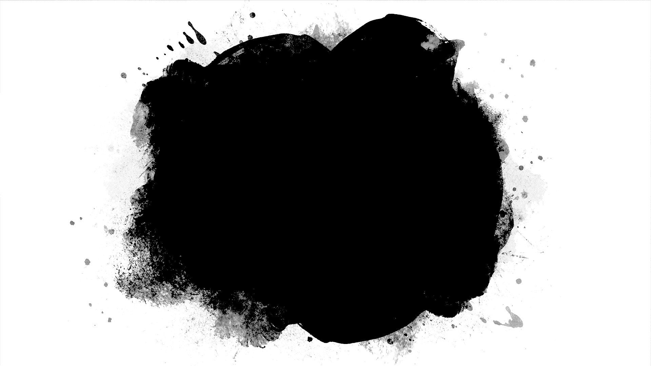
Basic Perceptron and Neural Nets

Slide 3
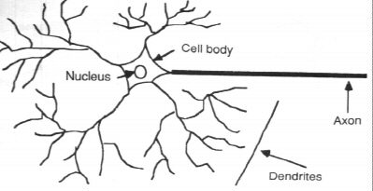
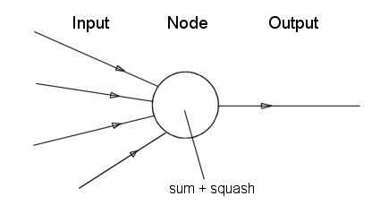
Neurone vs. Node

Slide 4
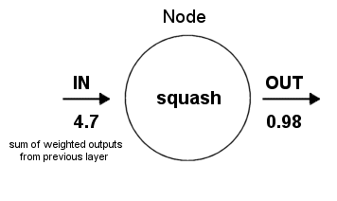
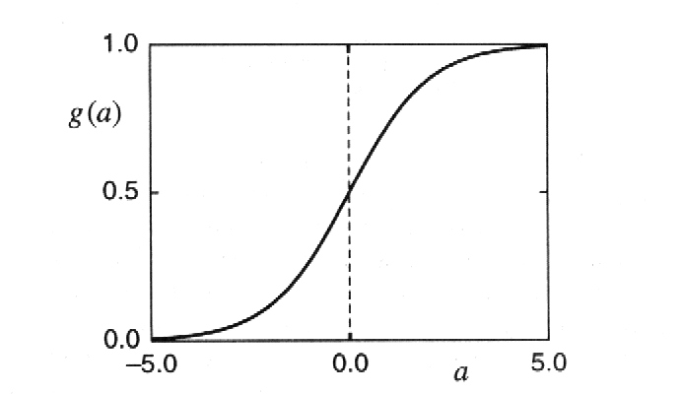
Structure of a node:
Squashing function limits node output:

Slide 5
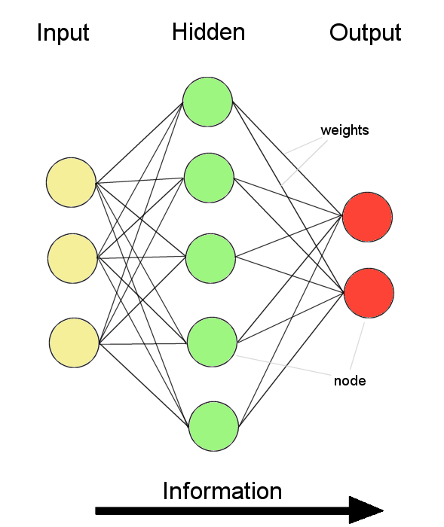
Feed-forward nets
Information flow is unidirectional
Data is presented to Input layer
Passed on to Hidden Layer
Passed on to Output layer
Information is distributed
Information processing is parallel
Internal representation (interpretation) of data

Slide 6
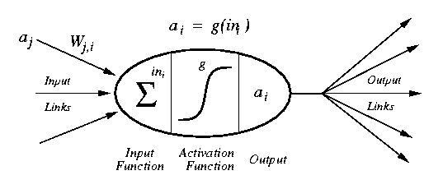
Modelling a Neuron
a_{j} :Activation value of unit j
w_{j,I} :Weight on the link from unit j to unit i
in_{I} :Weighted sum of inputs to unit i
a_{I} :Activation value of unit i
g :Activation function

Slide 7
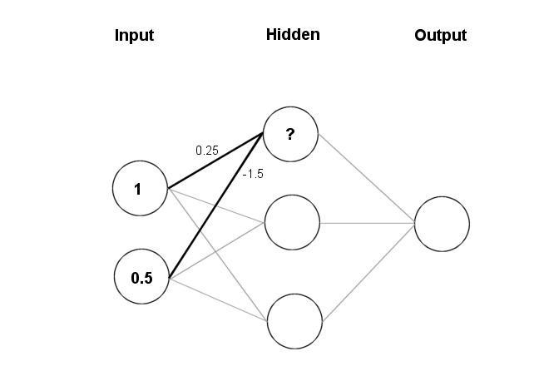
Feeding data through the net:
(1 × 0.25) + (0.5 × (-1.5)) = 0.25 + (-0.75) = - 0.5
Squashing:

Slide 8


Lets take a hypothetical example of a class and its TAs
PROF.
TAs

Slide 9
Lets take a hypothetical example of a class and its TAs
PROF.
TAs
Amar
Akbar
Anthony

Slide 10
A surprise quiz is conducted in the class on 31st Feb, 2019
The prof. asks her TAs, what they think would be the average score of the class

Slide 11
Lets take a hypothetical example of a class and its TAs
PROF.
TAs
Amar
Akbar
Anthony
Estimate of Avg. score, given by TAs
29
75
56

Slide 12
Since, all TAs are new, prof. trusts them equally.
PROF.
Trust factor of Prof. over his individual TAs
0.3
0.3
0.3
TAs
Amar
Akbar
Anthony
Estimate of Avg. score, given by TAs
29
75
56

Slide 13
Prof’s calculation of avg. score: Summation: 29(0.3) + 75(0.3) + 56(0.3) = 48 Simple Logic: y = [x] i.e. nearest integer function Therefore, prof’s guess is y = 48
PROF.
Trust factor of Prof. over his individual TAs
0.3
0.3
0.3
TAs
Amar
Akbar
Anthony
Estimate of Avg. score, given by TAs
29
75
56

Slide 14
Actual average = 63 Prof’s guess is y = 48
PROF.
Trust factor of Prof. over his individual TAs
0.3
0.3
0.3
TAs
Amar
Akbar
Anthony
Estimate of Avg. score, given by TAs
29
75
56

Slide 15
Difference in prediction: 63 – 48 = 15 Now Prof. realizes that the estimate given by Anthony was pretty close, and so the trust factor for Anthony should be increased greatly. Akbar’s estimate was second best, so its trust value should also be increased slightly. While Amar’s estimate was bad so his trust value should be decreased a little
PROF.
Trust factor of Prof. over his individual TAs
0.3
0.3
0.3
TAs
Amar
Akbar
Anthony
Estimate of Avg. score, given by TAs
29
75
56

Slide 16
Making appropriate changes to trust values
PROF.
Trust factor of Prof. over his individual TAs
0.3
0.3
0.3
- 0.2
+ 0.1
+ 0.2
TAs
Amar
Akbar
Anthony
Estimate of Avg. score, given by TAs
29
75
56

Slide 17
The changes in Trust values or say learning of trust values in the network is done by BACKPROPAGATION ALGORITHM
In this workshop we intend to give you a basic idea of what neural networks is, and so Backpropagation Algorithm is out of scope for this tutorial.
It is a part of your syllabus in classes INFO 6105 and CSYE 7245 and will most likely be covered in the next workshop on neural networks

Slide 18
Prof’s calculation of avg. score: Summation: 29(0.1) + 75(0.4) + 56(0.5) = 60.9 Simple Logic: y = [x] i.e. nearest integer function Therefore, prof’s guess is y = 61
PROF.
Trust factor of Prof. over his individual TAs
0.1
0.4
0.5
TAs
Amar
Akbar
Anthony
Estimate of Avg. score, given by TAs
29
75
56

Slide 19
Output
PROF.
Simple Logic /
Activation Function & Summation
Trust factor of Prof. over his individual TAs
0.1
0.4
0.5
Weights
TAs
Inputs
Amar
Akbar
Anthony
Estimate of Avg. score, given by TAs
29
75
56

Slide 20
Modelling a Neuron
a_{j} :Activation value of unit j
w_{j,I} :Weight on the link from unit j to unit i
in_{I} :Weighted sum of inputs to unit i
a_{I} :Activation value of unit i
g :Activation function

Slide 21
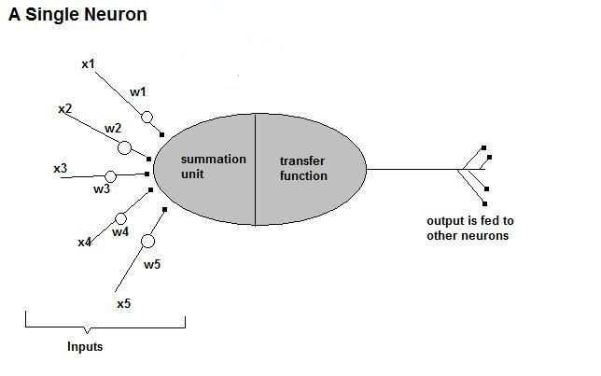

Slide 22
Feeding data through the net:
(1 × 0.25) + (0.5 × (-1.5)) = 0.25 + (-0.75) = - 0.5
Squashing:

Slide 23
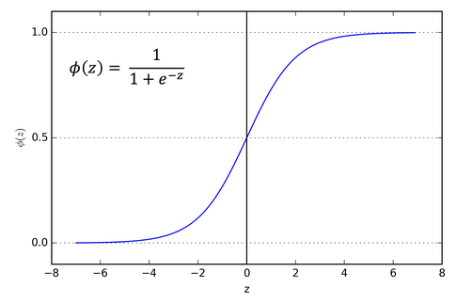
Activation Functions
Sigmoid / Logistic Function

Slide 24
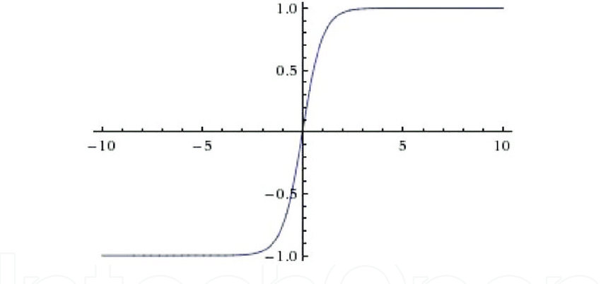
TanH Function

Slide 25
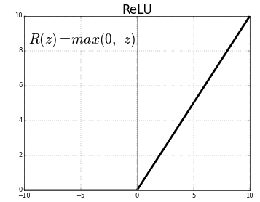
ReLU Function

Slide 26
The First Neural Neural Networks
X₁
1
Y
X₂
1
AND Function
Threshold(Y) = 2

Slide 27
The First Neural Neural Networks
X₁
2
Y
X₂
2
AND Function
OR Function
Threshold(Y) = 2

Slide 28
The First Neural Neural Networks
X₁
2
Y
X₂
-1
AND NOT Function
Threshold(Y) = 2

Slide 29
The First Neural Neural Networks
2
2
X₁
-1
Z₁
Y
X₂
-1
Z₂
2
2
XOR Function
X₁ XOR X₂ = (X₁ AND NOT X₂) OR (X₂ AND NOT X₁)

Slide 30

Making a Neural Net structure in our example
PROF.
Output Layer
0.7
0.3
Hidden Layer
TAs
0.3
0.2
0.1
0.75
Weights
0.5
0.15
Students
Input Layer
29
56
75

Slide 31
Introduction to Tensorflow

Slide 32

What is TensorFlow?
TensorFlow is a deep learning library recently open-sourced by Google.
But what does it actually do?
TensorFlow provides primitives for defining functions on tensors and automatically computing their derivatives.

Slide 33
Why Tensorflow?
Python API
Portability: deploy computation to one or more CPUs or GPUs in a desktop, server, or mobile device with a single API
Flexibility: from Raspberry Pi, Android, Windows, iOS, Linux to server farms
Visualization (TensorBoard is da bomb)
Checkpoints (for managing experiments)
Auto-differentiation autodiff (no more taking derivatives by hand. Yay)
Large community (> 10,000 commits and > 3000 TF-related repos in 1 year)
Awesome projects already using TensorFlow

Slide 34
What’s a Tensor?
An n-dimensional array
0-d tensor: scalar (number)
1-d tensor: vector
2-d tensor: matrix and so on

Slide 35

TensorFlow vs. Numpy
Few people make this comparison, but TensorFlow and Numpy are quite similar. (Both are N-d array libraries!)
Numpy has Ndarray support, but doesn’t offer methods to create tensor functions and automatically compute derivatives (+ no GPU support).
VS

Slide 36
Simple Numpy Recap
In [23]: import numpy as np
In [24]: a = np.zeros((2,2)); b = np.ones((2,2)) In [25]: np.sum(b, axis=1)
Out[25]: array([ 2., 2.])
In [26]: a.shape
Out[26]: (2, 2)
In [27]: np.reshape(a, (1,4))
Out[27]: array([[ 0., 0., 0.,
0.]])

Slide 37
More on Session
soon
Repeat in TensorFlow
More on .eval()
in a few slides
In [31]: import tensorflow as tf
In [32]: tf.InteractiveSession()
In [33]: a = tf.zeros((2,2)); b = tf.ones((2,2))
In [34]: tf.reduce_sum(b, reduction_indices=1).eval() Out[34]: array([ 2., 2.], dtype=float32)
In [35]: a.get_shape()
Out[35]: TensorShape([Dimension(2), Dimension(2)])
TensorShape behaves like a python tuple.
In [36]: tf.reshape(a, (1, 4)).eval()
Out[36]: array([[ 0., 0., 0., 0.]], dtype=float32)

Slide 38
Numpy to TensorFlow Dictionary
Numpy | TensorFlow
a = np.zeros((2,2)); b = np.ones((2,2)) | a = tf.zeros((2,2)), b = tf.ones((2,2))
np.sum(b, axis=1) | tf.reduce_sum(a,reduction_indices=[1])
a.shape | a.get_shape()
np.reshape(a, (1,4)) | tf.reshape(a, (1,4))
b * 5 + 1 | b * 5 + 1
np.dot(a,b) | tf.matmul(a, b)
a[0,0], a[:,0], a[0,:] | a[0,0], a[:,0], a[0,:]

Slide 39
TensorFlow requires explicit evaluation!
In [37]: a = np.zeros((2,2))
In [38]: ta = tf.zeros((2,2))
TensorFlow computations define a computation graph that has no numerical value until evaluated!
In [39]: print(a)
[[ 0. 0.]
[ 0. 0.]]
In [40]: print(ta)
Tensor("zeros_1:0", shape=(2, 2), dtype=float32)
In [41]: print(ta.eval())
[[ 0. 0.]
[ 0. 0.]]

Slide 40
Basic Code Structure - Graphs
Constants are fixed value tensors - not trainable
Variables are tensors initialized in a session - trainable
Placeholders are tensors of values that are unknown during the graph construction, but passed as input during a session
Ops are functions on tensors

Slide 41
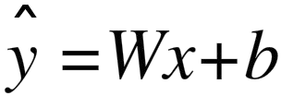
Basic Code Structure - Graphs
Add
Mul
b
variable
variable ops placeholder
W
x

Slide 42
Basic Code Structure - Sessions
Add
Mul
b
variable
variable ops placeholder
W
x

Slide 43
TensorFlow Session Object
“A Session object encapsulates the environment in which Tensor objects are evaluated” - TensorFlow Docs
In [20]: a = tf.constant(5.0)
In [21]: b = tf.constant(6.0)
c.eval() is just syntactic sugar for sess.run(c) in the currently active session!
In [22]: c = a * b
In [23]: with tf.Session() as sess:
....:
....:
....: 30.0
30.0
print(sess.run(c)) print(c.eval())

Slide 44
TensorFlow Variables (1)
“When you train a model you use variables to hold and update parameters. Variables are in-memory buffers containing tensors” - TensorFlow Docs.

Slide 45
TensorFlow Variables (2)
In [32]: W1 = tf.ones((2,2))
In [33]: W2 = tf.Variable(tf.zeros((2,2)), name="weights") In [34]: with tf.Session() as sess:
print(sess.run(W1)) sess.run(tf.initialize_all_variables()) print(sess.run(W2))
....:
Note the initialization step tf. initialize_all_variables()
[[ | 1. | 1.]
[ | 1. | 1.]]
[[ | 0. | 0.]
[ | 0. | 0.]]

Slide 46
TensorFlow Variables (3)
TensorFlow variables must be initialized before they have
values! Contrast with constant tensors.
Variable objects can be initialized from constants or random values
In [38]: W = tf.Variable(tf.zeros((2,2)), name="weights")
In [39]: R = tf.Variable(tf.random_normal((2,2)), name="random_weights")
In [40]: with tf.Session() as sess:
....:
....:
....:
....:
sess.run(tf.initialize_all_variables()) print(sess.run(W))
print(sess.run(R))
Initializes all variables with specified values.

Slide 47
Updating Variable State
In [63]: state = tf.Variable(0, name="counter")
In [64]: new_value = tf.add(state, tf.constant(1))
Roughly new_value = state + 1
In [65]: update = tf.assign(state, new_value)
Roughly state = new_value
In [66]: with tf.Session() as sess:
Roughly
state = 0
print(state)
for _ in range(3): state = state + 1 print(state)
....:
....:
....:
....:
....:
....:
sess.run(tf.initialize_all_variables()) print(sess.run(state))
for _ in range(3): sess.run(update) print(sess.run(state))
0
1
2
3

Slide 48
Fetching Variable State (1)
In [82]: input1 = tf.constant(3.0) In [83]: input2 = tf.constant(2.0) In [84]: input3 = tf.constant(5.0)
In [85]: intermed = tf.add(input2, input3) In [86]: mul = tf.mul(input1, intermed)
In [87]: with tf.Session() as sess:
Calling sess.run(var) on a tf.Session() object retrieves its value. Can retrieve multiple variables simultaneously with sess.run([var1, var2]) (See Fetches in TF docs)
....:
....:
....:
[21.0, 7.0]
result = sess.run([mul, intermed]) print(result)

Slide 49
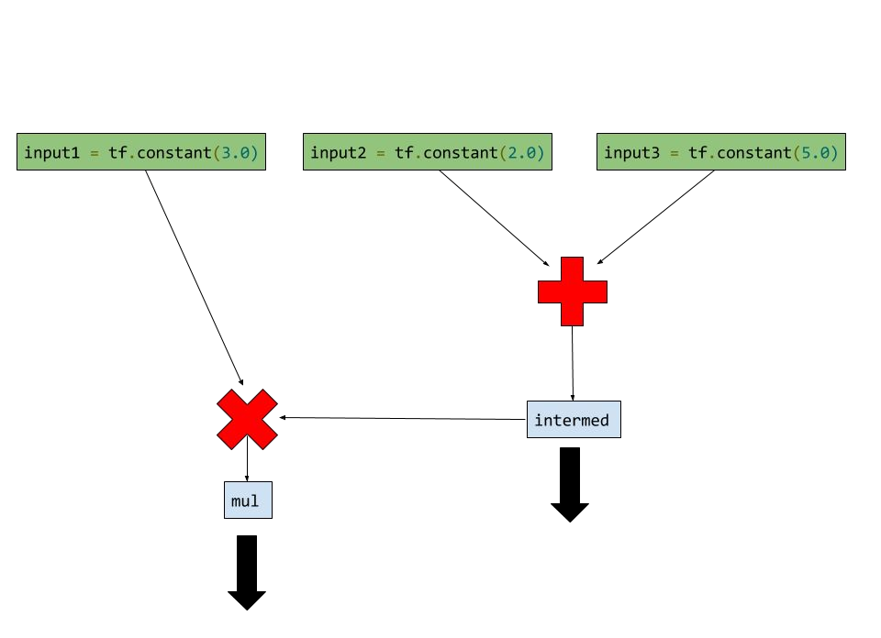
Fetching Variable State (2)

Slide 50
Inputting Data
All previous examples have manually defined tensors. How can we input external data into TensorFlow?
Simple solution: Import from Numpy:
In [93]: a = np.zeros((3,3))
In [94]: ta = tf.convert_to_tensor(a) In [95]: with tf.Session() as sess:
....: print(sess.run(ta))
....:
[[ 0. 0. 0.]
[ 0. 0. 0.]
[ 0. 0. 0.]]

Slide 51
Placeholders and Feed Dictionaries (1)
Inputting data with tf.convert_to_tensor() is convenient, but doesn’t scale.
Use tf.placeholder variables (dummy nodes that provide entry points for data to computational graph).
A feed_dict is a python dictionary mapping from tf. placeholder vars (or their names) to data (numpy arrays, lists, etc.).

Slide 52
Placeholders and Feed Dictionaries (2)
In [96]: input1 = tf.placeholder(tf.float32)
Define tf.placeholder
objects for data entry.
In [97]: input2 = tf.placeholder(tf.float32)
In [98]: output = tf.mul(input1, input2)
In [99]: with tf.Session() as sess:
....: print(sess.run([output], feed_dict={input1:[7.], input2:[2.]}))
....:
[array([ 14.], dtype=float32)]
Fetch value of output from computation graph.
Feed data into computation graph.

Slide 53
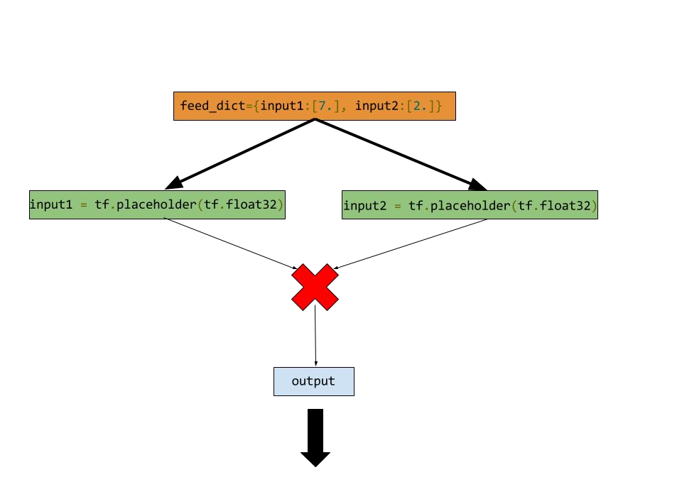
Placeholders and Feed Dictionaries (3)

Slide 54
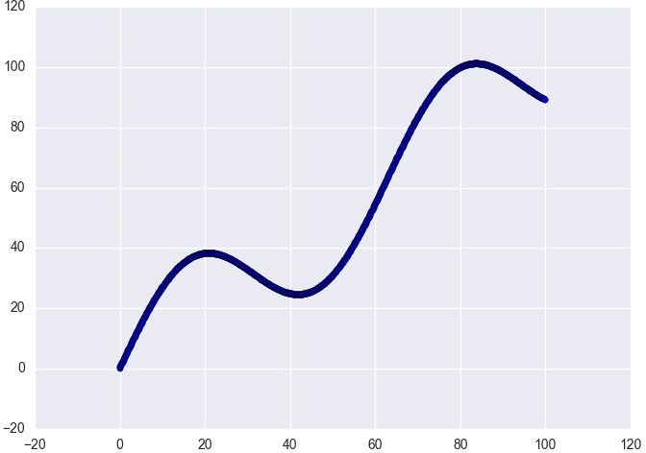
Ex: Linear Regression in TensorFlow (1)
import numpy as np import seaborn
# Define input data
X_data = np.arange(100, step=.1)
y_data = X_data + 20 * np.sin(X_data/10)
# Plot input data plt.scatter(X_data, y_data)

Slide 55
Ex: Linear Regression in TensorFlow (2)
# Define data size and batch size n_samples = 1000
batch_size = 100
# Tensorflow is finicky about shapes, so resize X_data = np.reshape(X_data, (n_samples,1)) y_data = np.reshape(y_data, (n_samples,1))
# Define placeholders for input
X = tf.placeholder(tf.float32, shape=(batch_size, 1)) y = tf.placeholder(tf.float32, shape=(batch_size, 1))

Slide 56
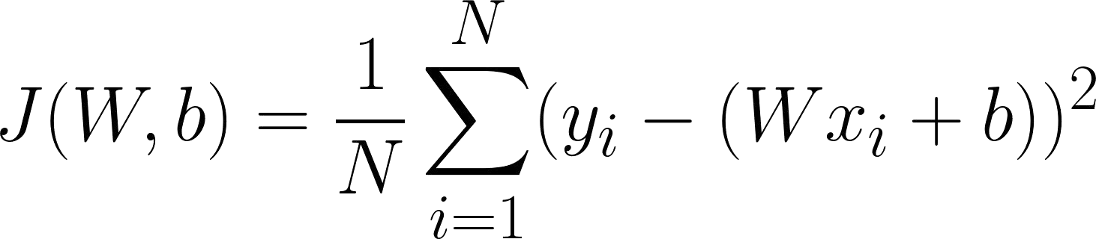
Ex: Linear Regression in TensorFlow (3)
# Define variables to be learned
with tf.variable_scope("linear-regression"): W = tf.get_variable("weights", (1, 1),
Note reuse=False so these tensors are created anew
initializer=tf.random_normal_initializer()) b = tf.get_variable("bias", (1,),
initializer=tf.constant_initializer(0.0)) y_pred = tf.matmul(X, W) + b
loss = tf.reduce_sum((y - y_pred)**2/n_samples)

Slide 57
Ex: Linear Regression in TensorFlow (4)
# Sample code to run one step of gradient descent In [136]: opt = tf.train.AdamOptimizer()
Note TensorFlow scope is not python scope! Python variable loss is still visible.
In [137]: opt_operation = opt.minimize(loss)
In [138]: with tf.Session() as sess:
.....:
.....:
.....:
sess.run(tf.initialize_all_variables()) sess.run([opt_operation], feed_dict={X: X_data, y: y_data})

Slide 58
Ex: Linear Regression in TensorFlow (4)
# Sample code to run full gradient descent: # Define optimizer operation
opt_operation = tf.train.AdamOptimizer().minimize(loss)
with tf.Session() as sess:
# Initialize Variables in graph sess.run(tf.initialize_all_variables()) # Gradient descent loop for 500 steps for _ in range(500):
# Select random minibatch
indices = np.random.choice(n_samples, batch_size) X_batch, y_batch = X_data[indices], y_data[indices] # Do gradient descent step
Let’s do a deeper. graphical dive into this operation
_, loss_val = sess.run([opt_operation, loss], feed_dict={X: X_batch, y: y_batch})

Slide 59
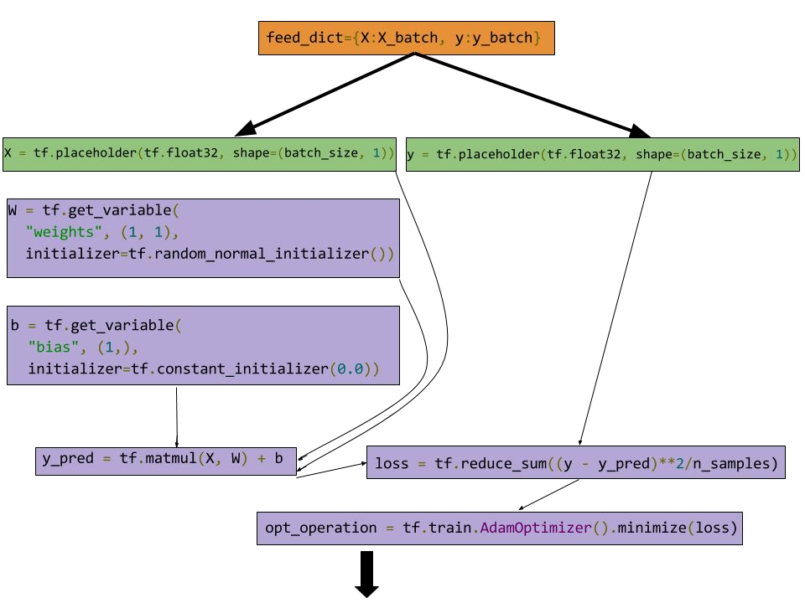
Ex: Linear Regression in TensorFlow (5)

Slide 60
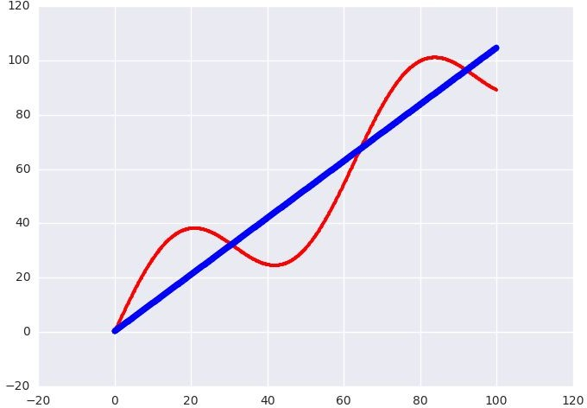
Ex: Linear Regression in TensorFlow (6)
Learned model offers nice fit to data.

Slide 61
Visualizing Tensorflow using Tensorboard

Slide 62
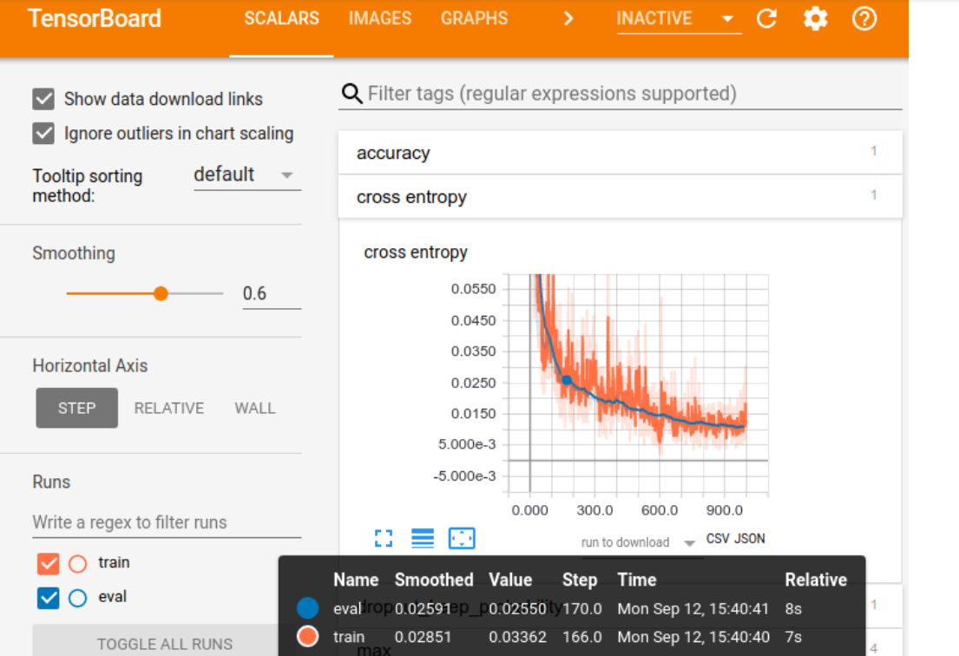
TensorBoard: Visualizing Learning

Slide 63
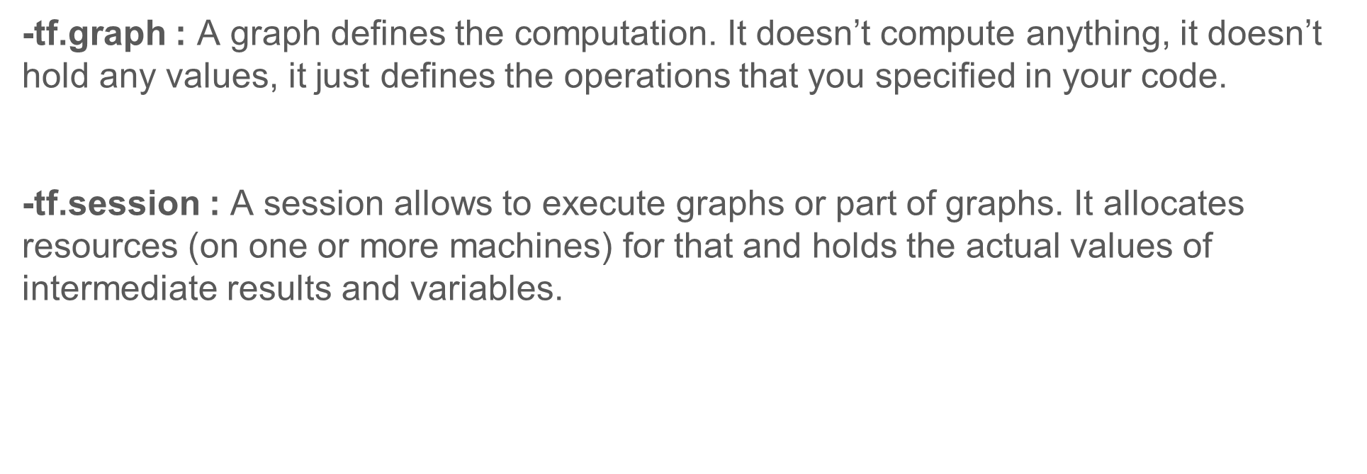

Slide 64
TensorFlow creates a default graph for you, so we don’t need the first two lines of the code above.
graph = tf.Graph()
with graph.as_default():
variable = tf.Variable(42, name='foo')
initialize = tf.global_variables_initializer()
assign = variable.assign(13)

Slide 65
Running Computations in a Session
To run any of the three defined operations, we need to create a session for that graph. The session will also allocate memory to store the current value of the variable.
with tf.Session(graph=graph) as sess:
sess.run(initialize)
sess.run(assign)
print(sess.run(variable))

Slide 66
DEMO

Slide 67
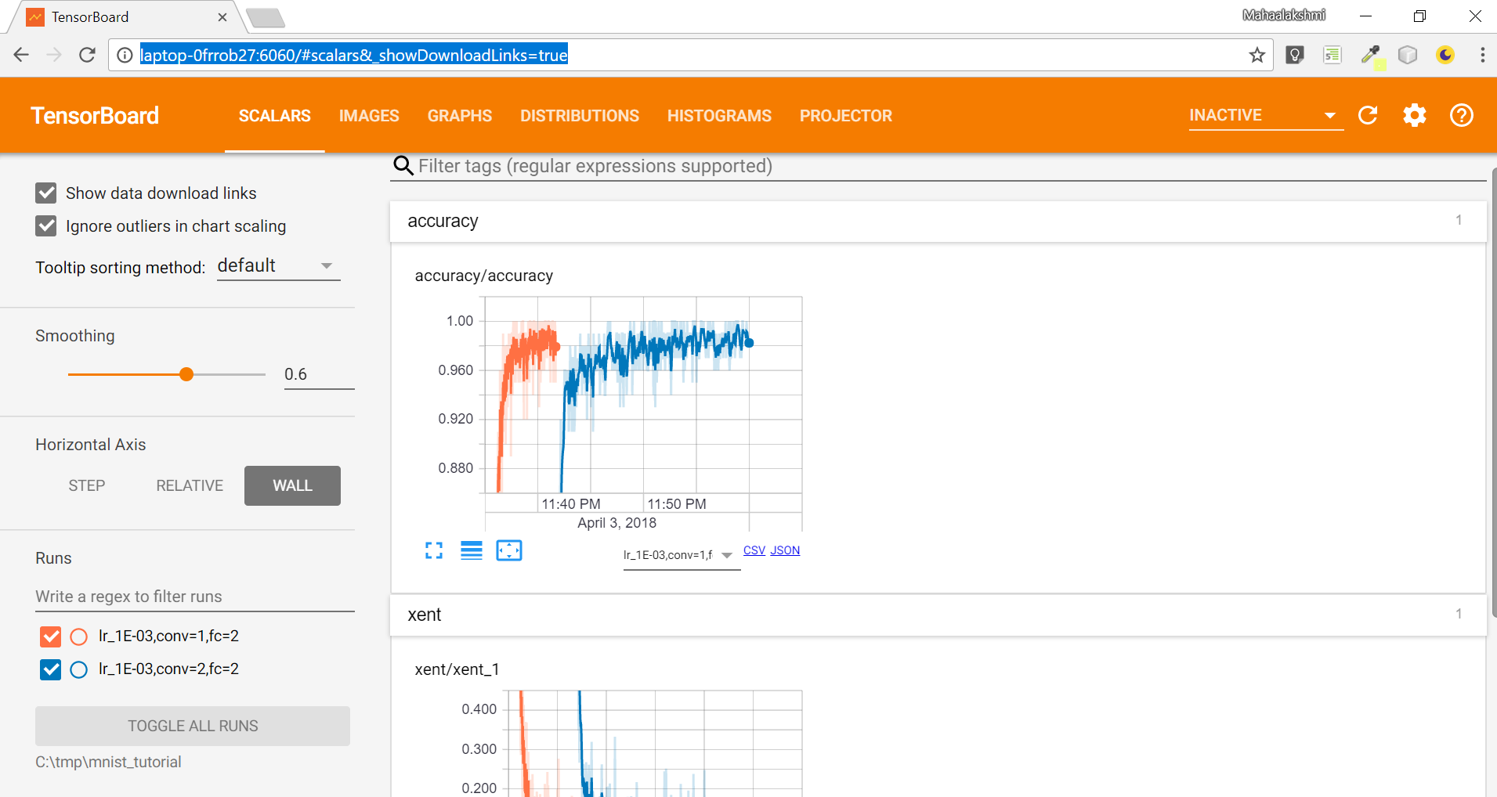
SCALARS TAB

Slide 68
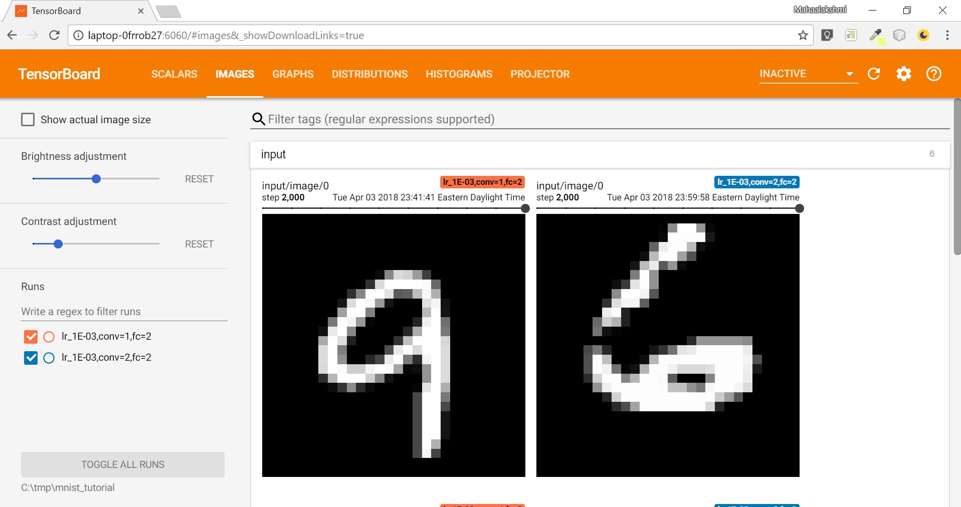
IMAGES TAB

Slide 69
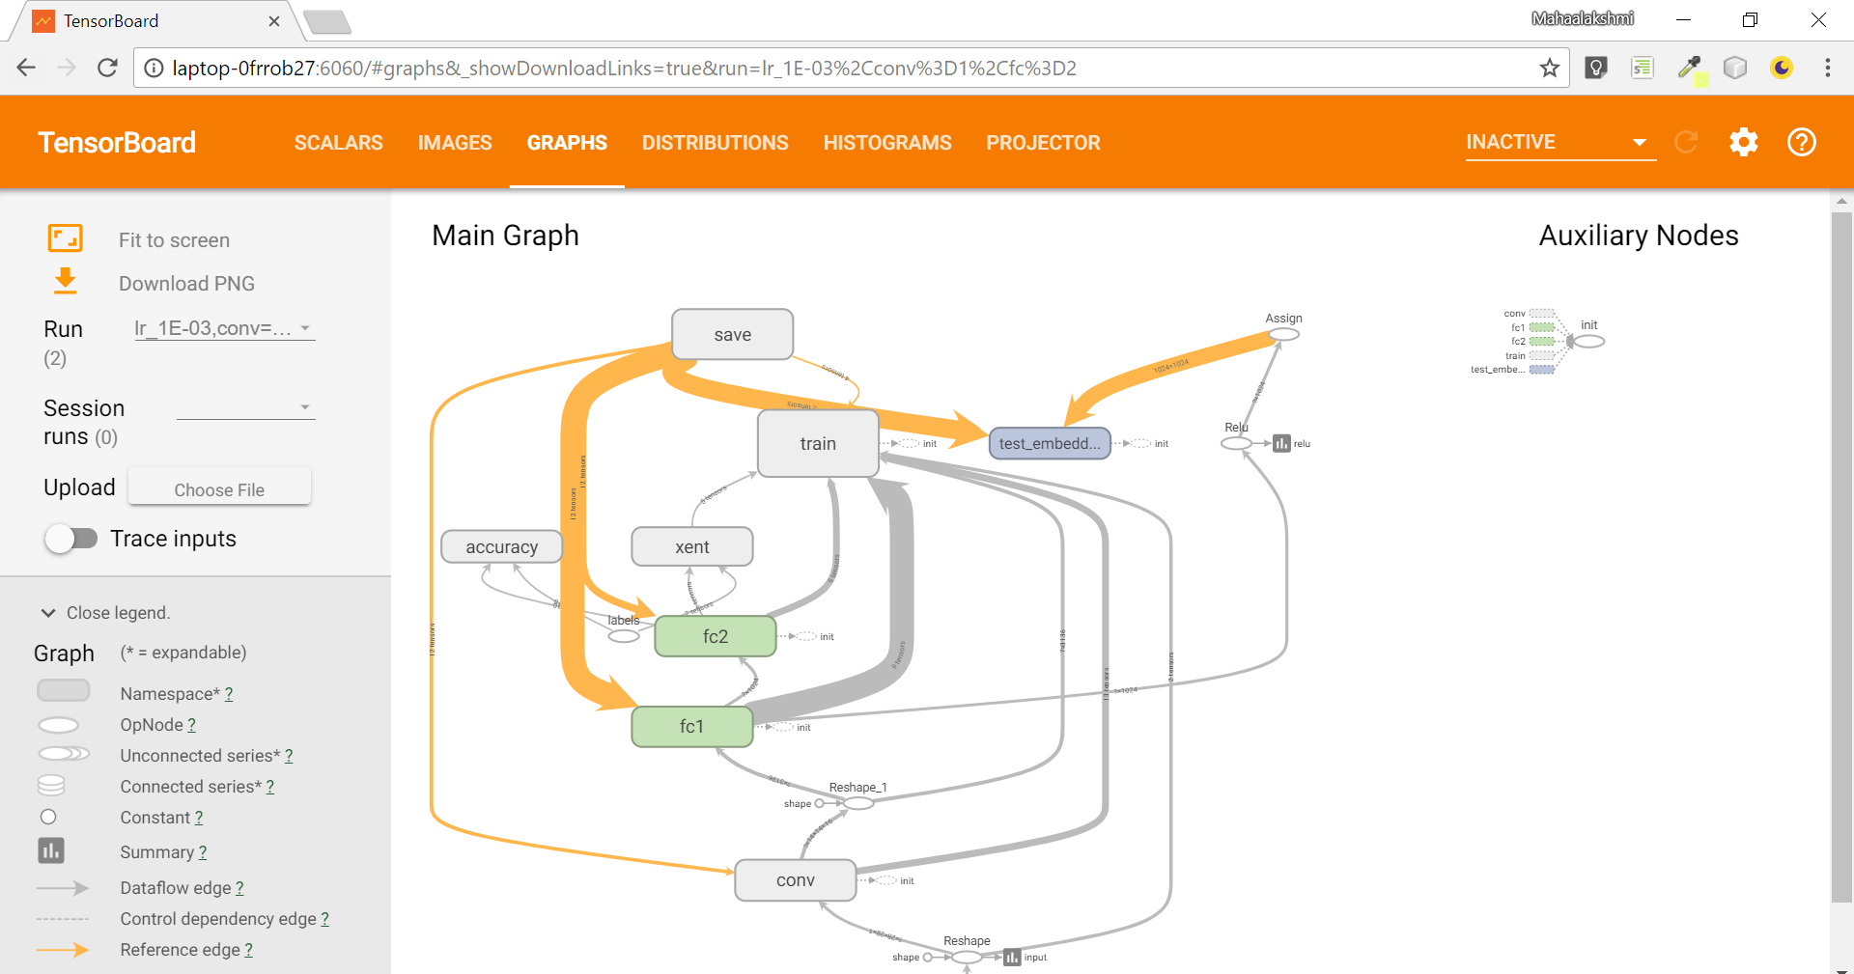
GRAPHS TAB

Slide 70
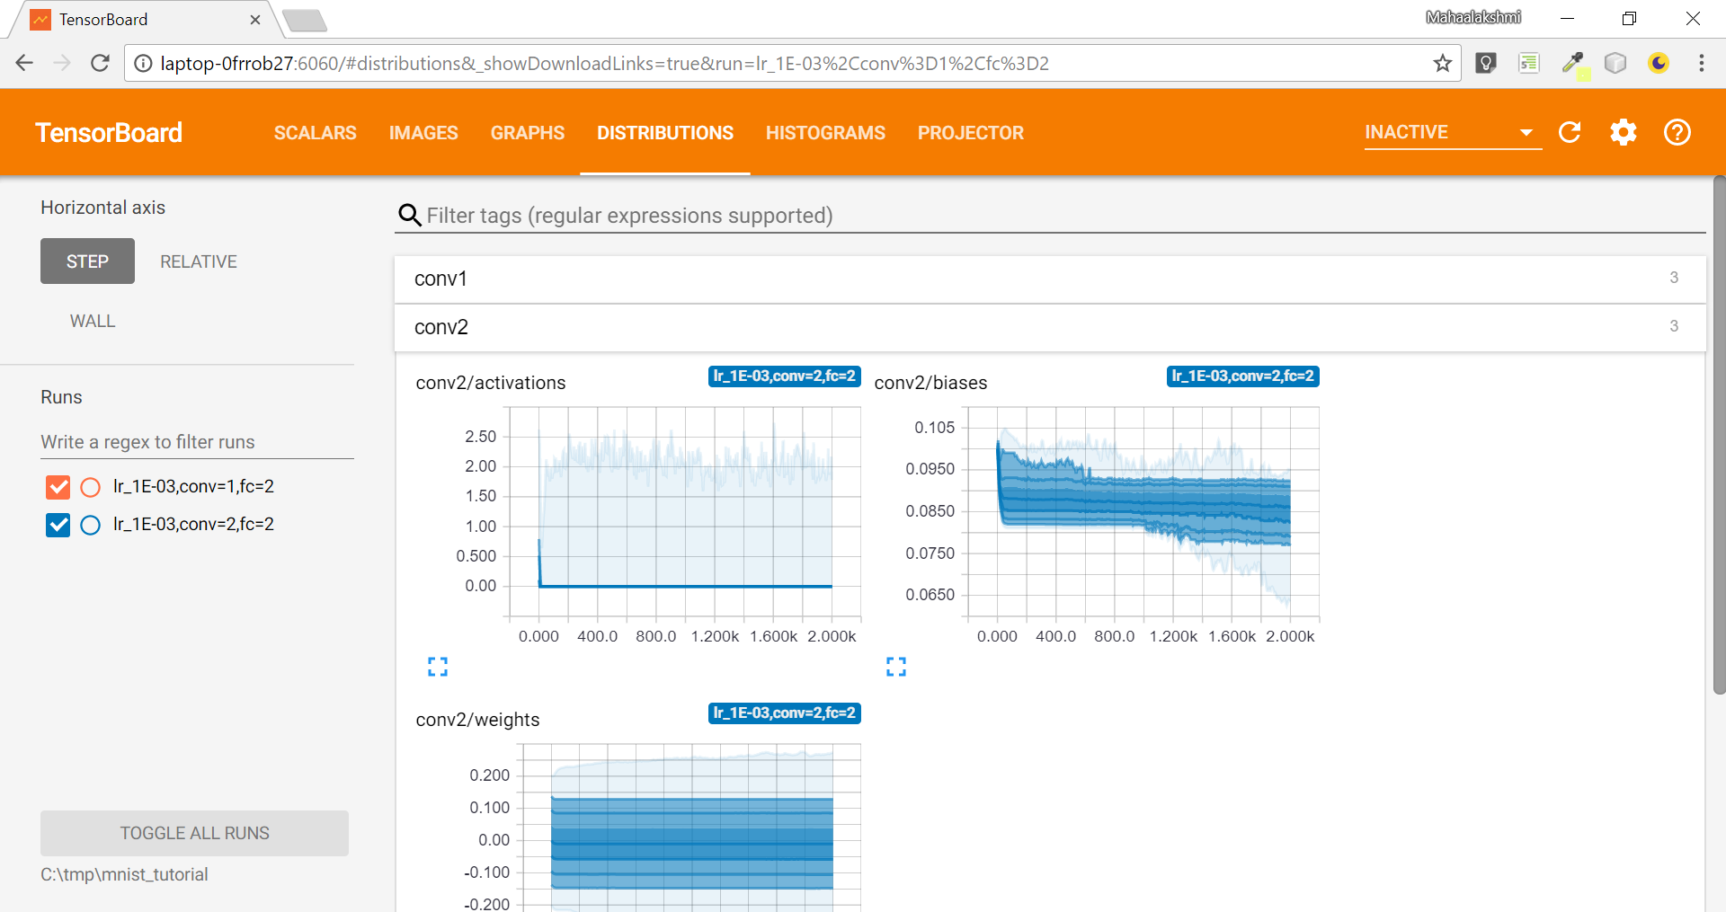
DISTRIBUTIONS TAB

Slide 71
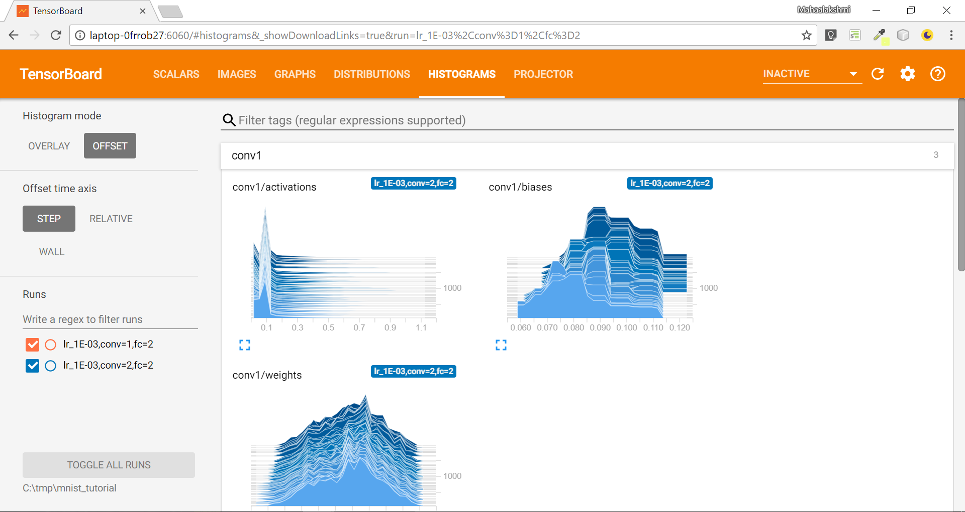

Slide 72
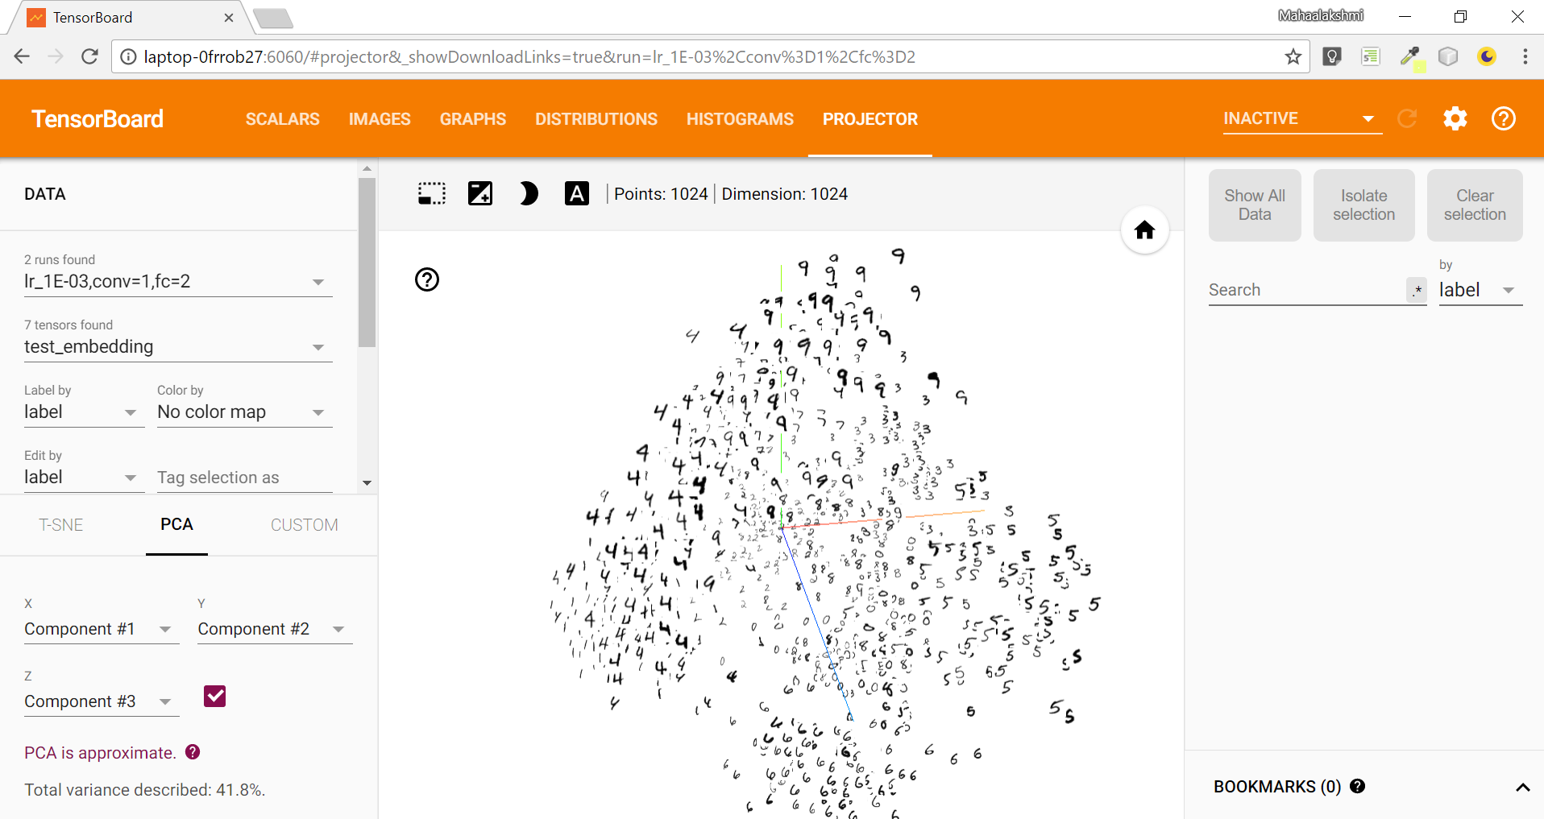
PROJECTOR TAB

Slide 73
The Embedding Projector
t-SNE: a nonlinear nondeterministic algorithm (T-distributed stochastic neighbor embedding) that tries to preserve local neighborhoods in the data, often at the expense of distorting global structure. You can choose whether to compute two- or three-dimensional projections.
PCA: a linear deterministic algorithm (principal component analysis) that tries to capture as much of the data variability in as few dimensions as possible. PCA tends to highlight large-scale structure in the data, but can distort local neighborhoods. The Embedding Projector computes the top 10 principal components, from which you can choose two or three to view.
Custom: a linear projection onto horizontal and vertical axes that you specify using labels in the data.

Slide 74
Thank you !!

